Slide 1
2 inputs
X and Y inputs

Slide 2
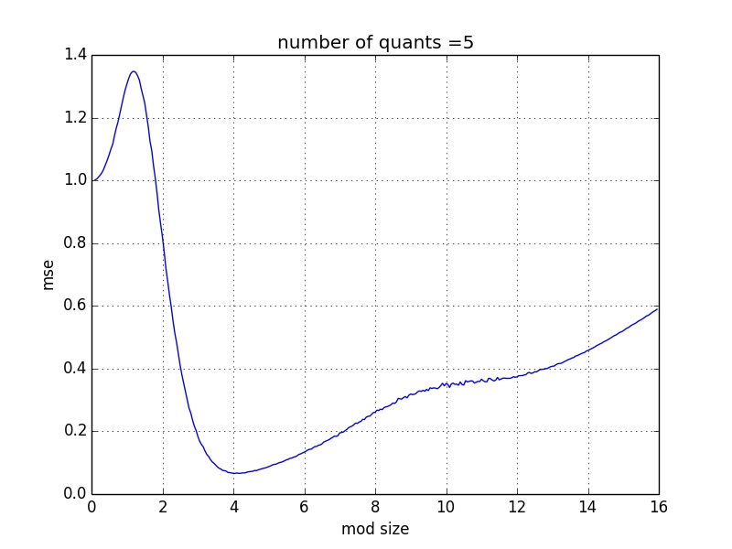
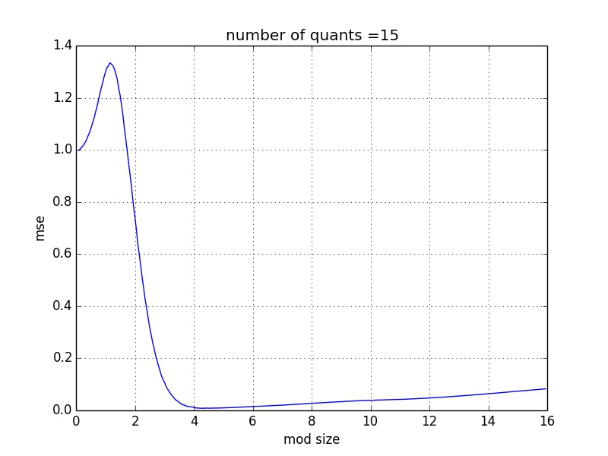
Y without quantization and modulo
in this case it’s like X~N(0,1) without y
lets see X MSE per modulo size:
for 5 quants: | for 15 quants:

Slide 3
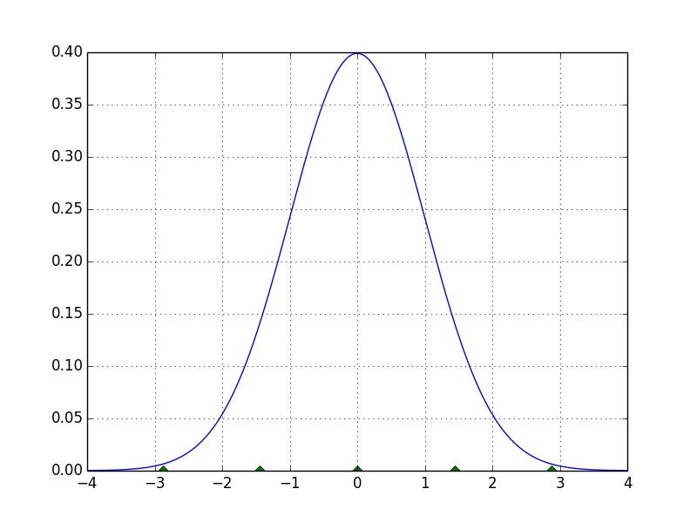
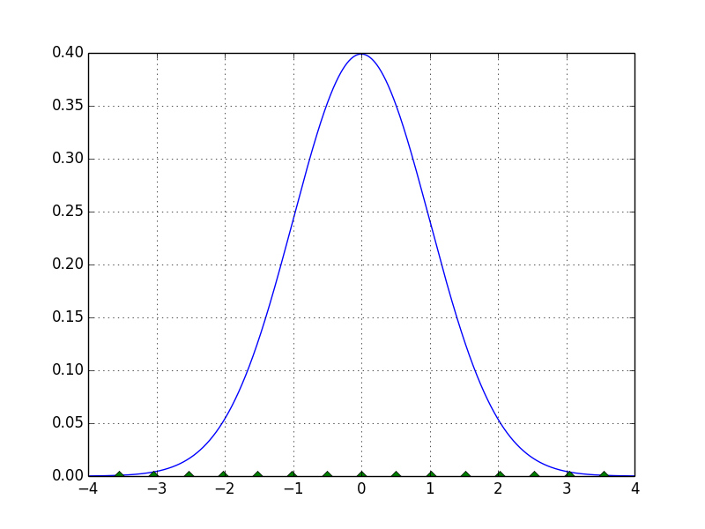
continue
the best modulo size is about the same place for all number of quants, but as we have more quants, we have less errors when we take bigger modulo size.
here is a quantizer on ~N(0,1)
the modulo is half bin beyond the last quantizer
for 5 quants: | for 15 quants:

Slide 4
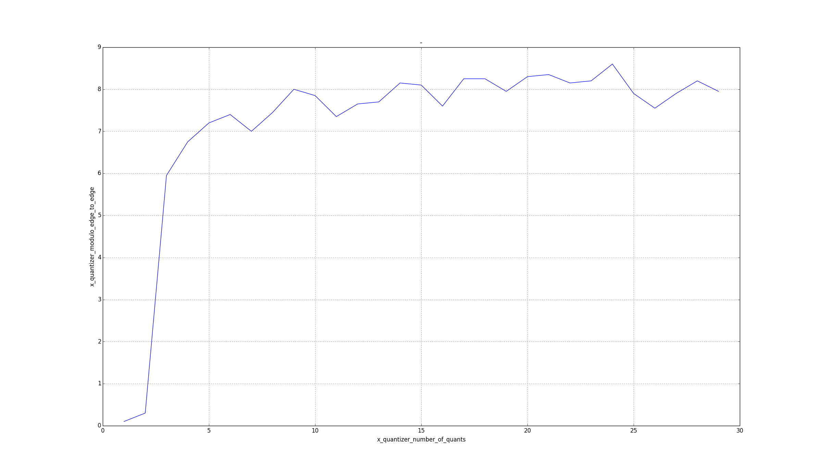
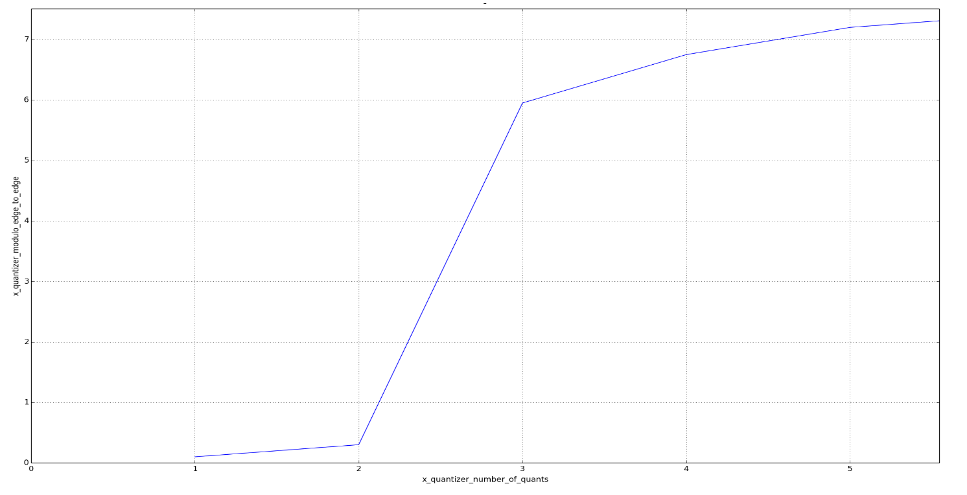
best modulo size (edge to edge) per number of quants

Slide 5
quantized Y without modulo
lets quantize Y without doing modulo on it and see how the quantization is influencing on X MSE

Slide 6
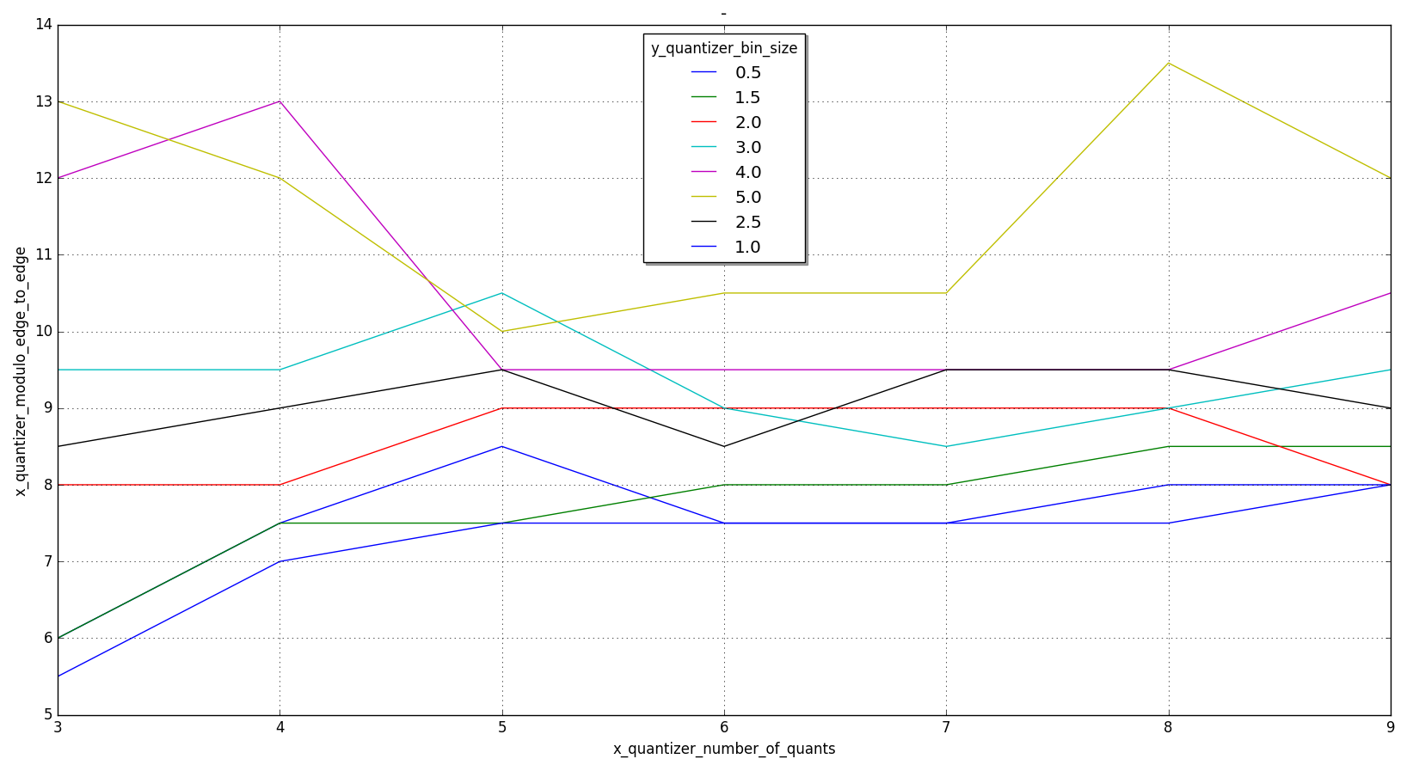
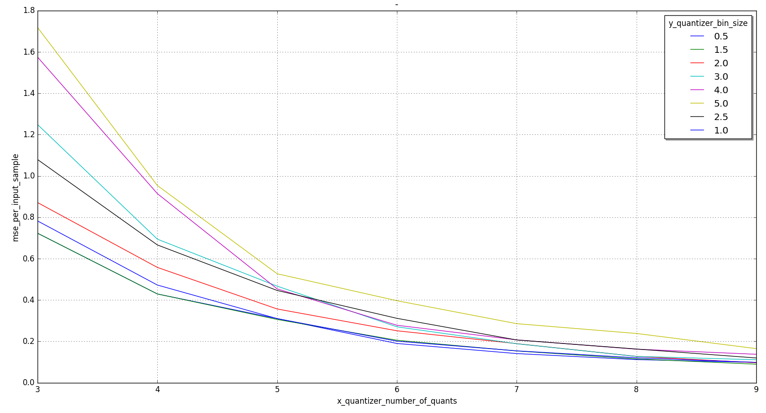
continue explains at the next slide

Slide 7
continue
the conditional variance between Y and X is 1, when we quantizes Y with big bins, we do the same operation like enlarging the conditional variance between them
when the conditional variance between Y and X is bigger than what should be by the relevant modulo size, we will start to get ‘wrong’ distance between X and Y. we need bigger modulo size to cover those errors
here you can see that the simulation is looking for larger modulo size to get better MSE

Slide 8
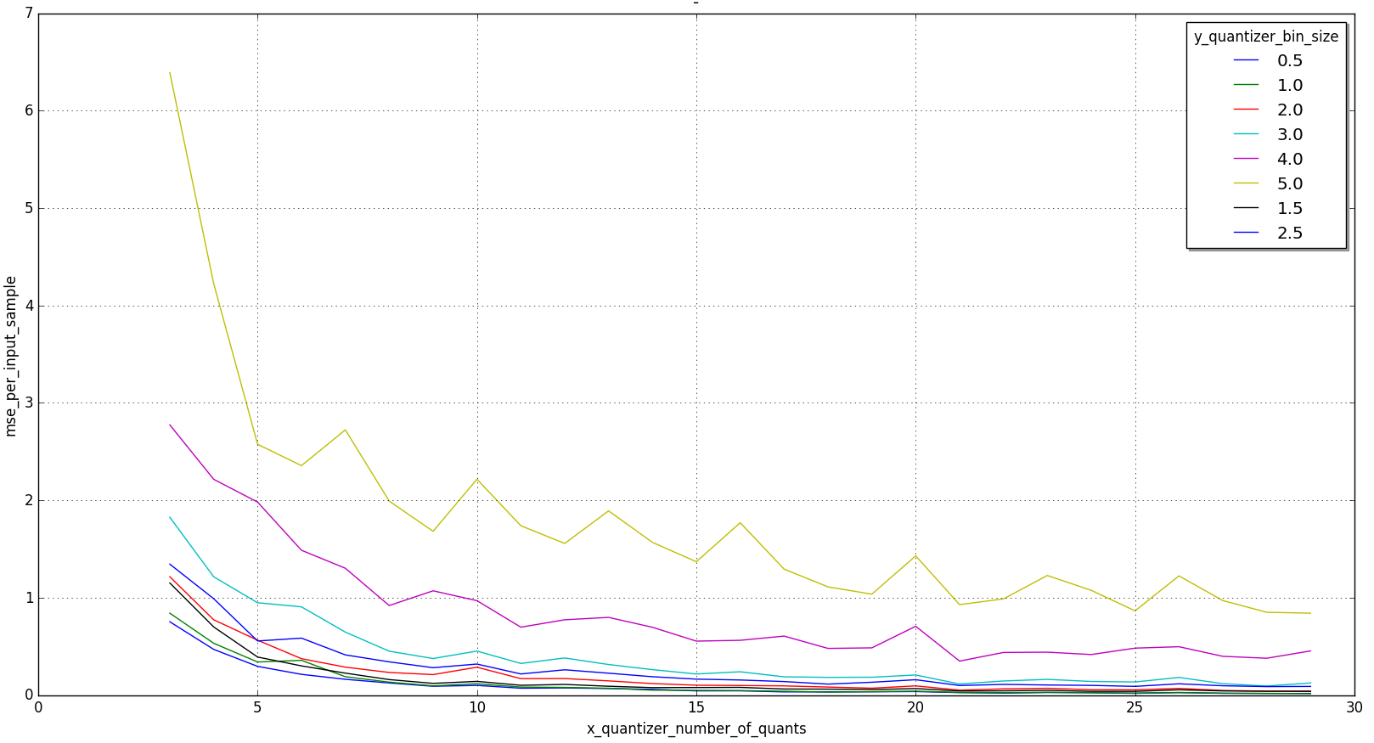
fixed X quantizer
now lets take a fixed quantizer for X, and start playing with Y quantization
we see that as we use bigger bin size for Y, the MSE for X gets worst.

Slide 9
fixed vs non fixed X quantizer
we can see that when we use fixed X quantizer, we get worst MSE
that is because the next graph
if we’re not at the optimum modulo size we will get less good MSE
but moving left (at fixed) is worse than moving right (non fixed) on the graph

